Slide 1


DESIGNING YOUR GYM APP
Insight into the software development process and how you can help.
https://unsplash.com/photos/woman-exercising-in-gym-DC5akQJyH4I
Notes:
Hello and welcome to our presentation for the design of your gym app.
This presentation is intended to give you information and insight into the software development process for your gym management app.
It will give an overview of the software development cycle, proposed system architecture and how you can help in making your app the best it can be.
The presentation will cover the requirements gathering process and how we will ensure your app is best for you.
We will also discuss how we will ensure that the product we produce is delivered to a high standard and leaves you satisfied.

Slide 2
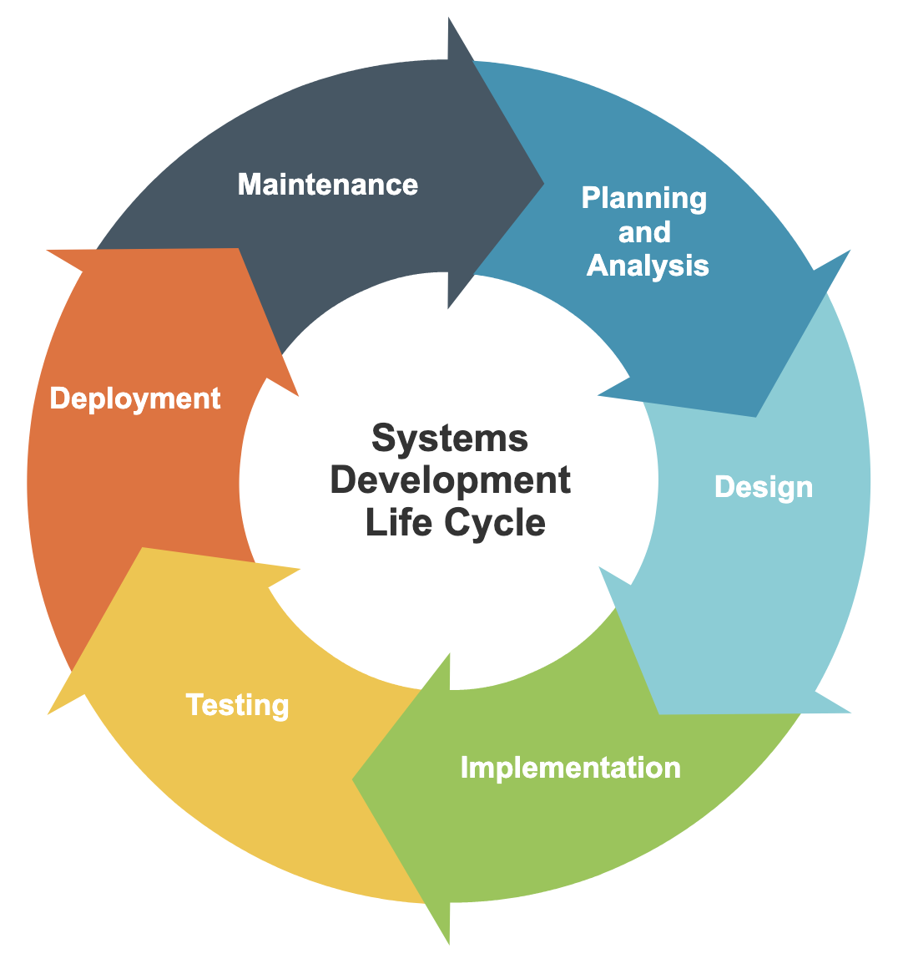
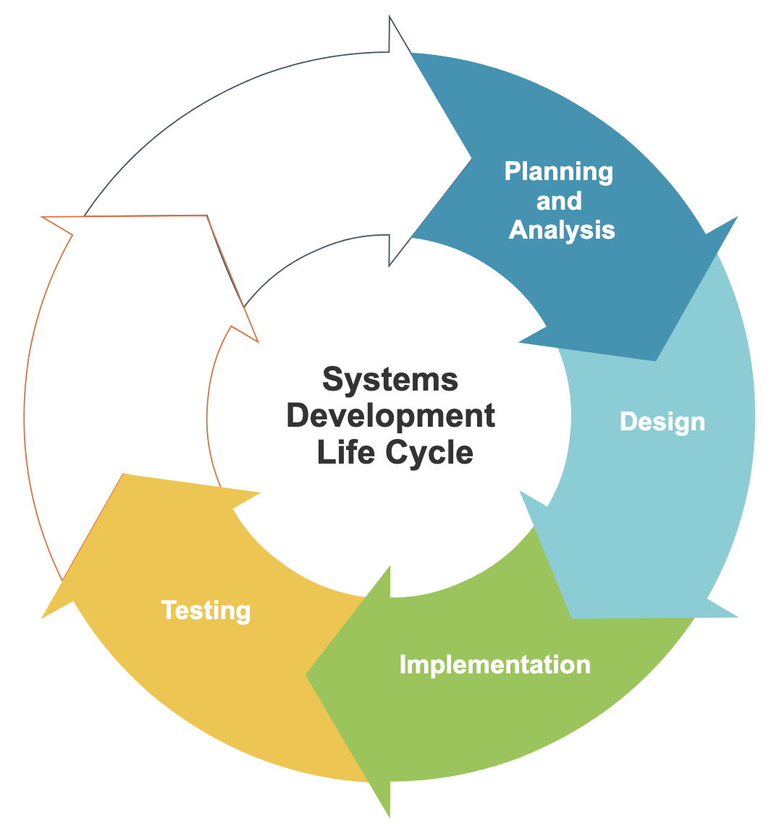
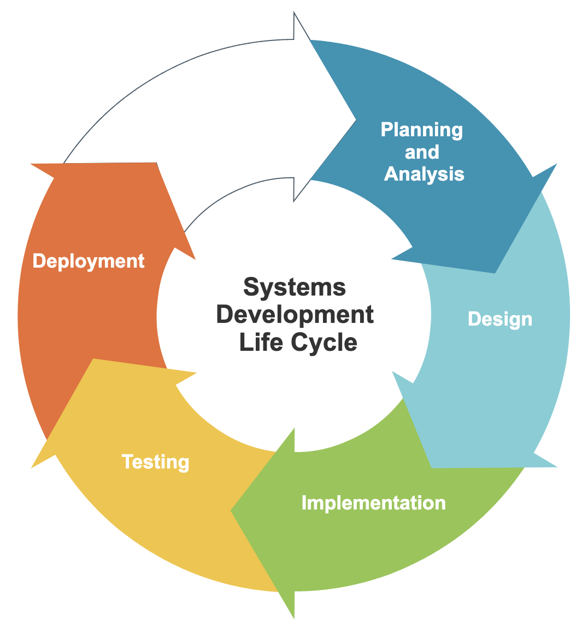
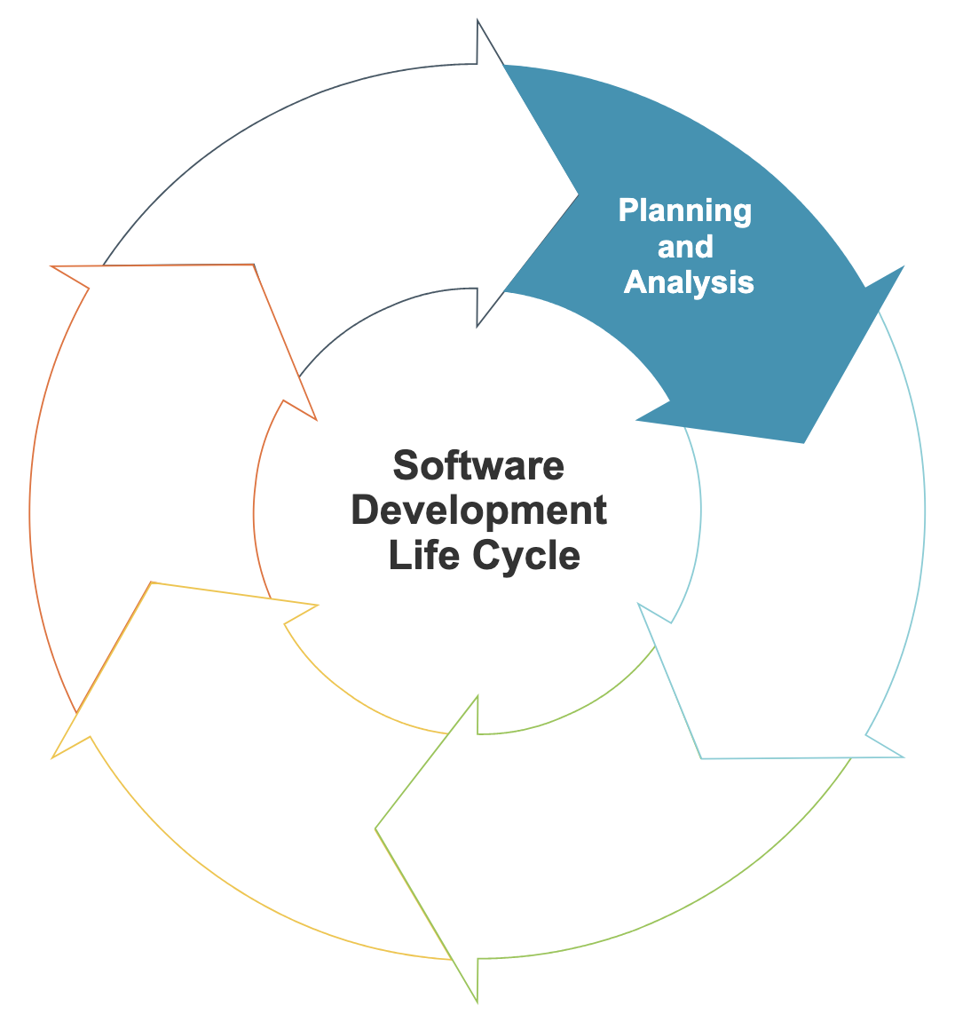
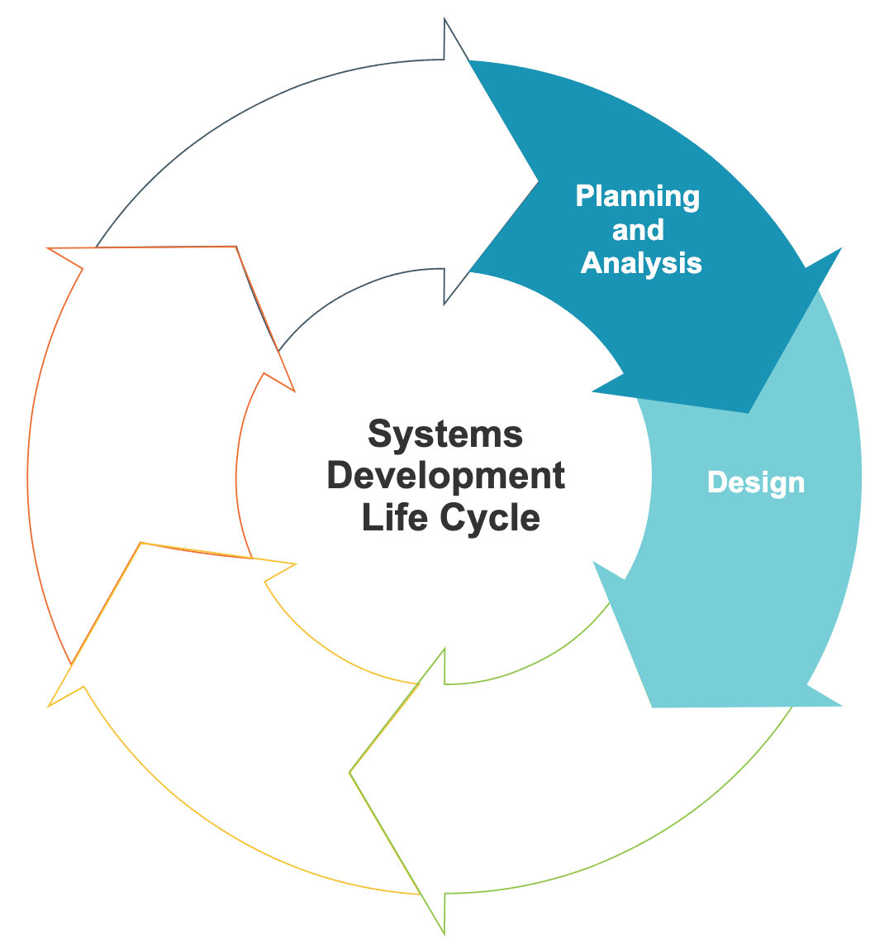
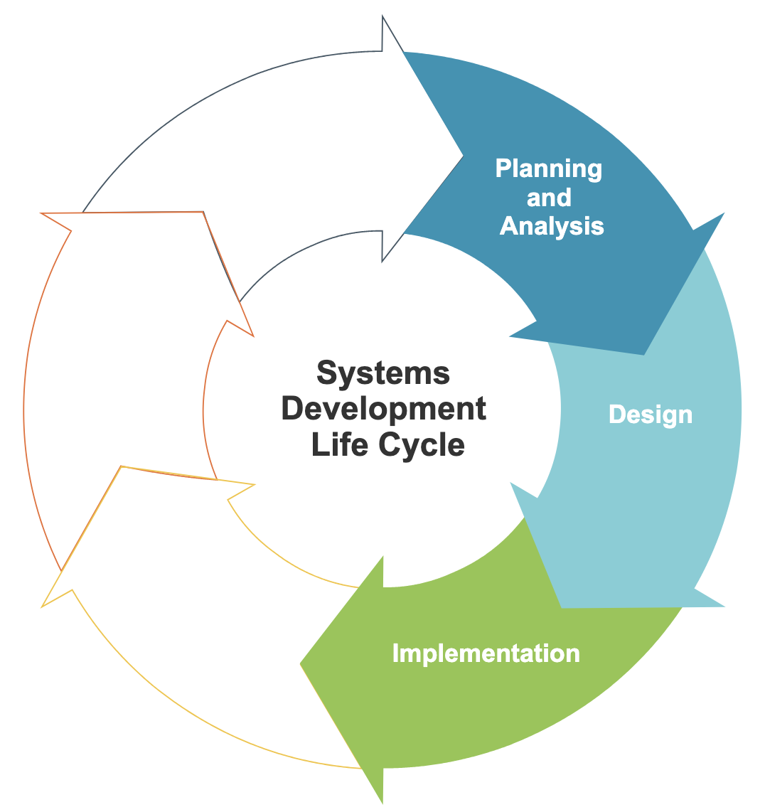
The Software Development Life Cycle
What is it and why do we use it?
https://app.smartdraw.com/
Notes:
The software development life cycle refers to a process which is implemented to help design teams plan, design, implement, test , deploy and maintain high-quality software products.
The process consists of 6 distinct phases.
Planning and Analysis – This phase is where the software requirements are gathered from all the relevant stakeholders involved with the project.
This information can then form a key part of the planning for the design team to make decisions on project cost, timelines for deliverables and resources required to produce the software.
During this phase, you can also set and agree on priorities for the stakeholder requirements.
Design – Once the requirements are fully agreed with the stakeholders the designers can then start to make decisions on how they are going to produce the software to meet the stakeholder requirements.
This involves choosing the system architecture, which best practices to employ in the design and how this new product might interact with any existing services or interfaces.
Implementation – This is where you put your planning and design into practice through coding. This phase is what turns the ideas of the previous phases into actual tangible deliverables in the form of features and products.
Testing – Testing forms a key part of the software development process and ensures that the product that is delivered is to a high standard and meets all the agreed stakeholder requirements. It is very common for this phase to run in parallel with the implementation phase to help prevent the concatenation of issues later down the line.
Deployment – This phase is when a version of the software product is released to its users. This version released to the users is like a kind of snapshot of the product at that moment in time, this allows the development team to continue working on the product if required whilst the users still have access to the product.
Maintenance – During the testing phase in development bugs and errors in the code may persist after the product has been released as testing can never be practically comprehensive.
For this reason, it is key that a robust maintenance strategy is put in place to make sure bugs in production are dealt with efficiently to maintain an enjoyable user experience.

Slide 3
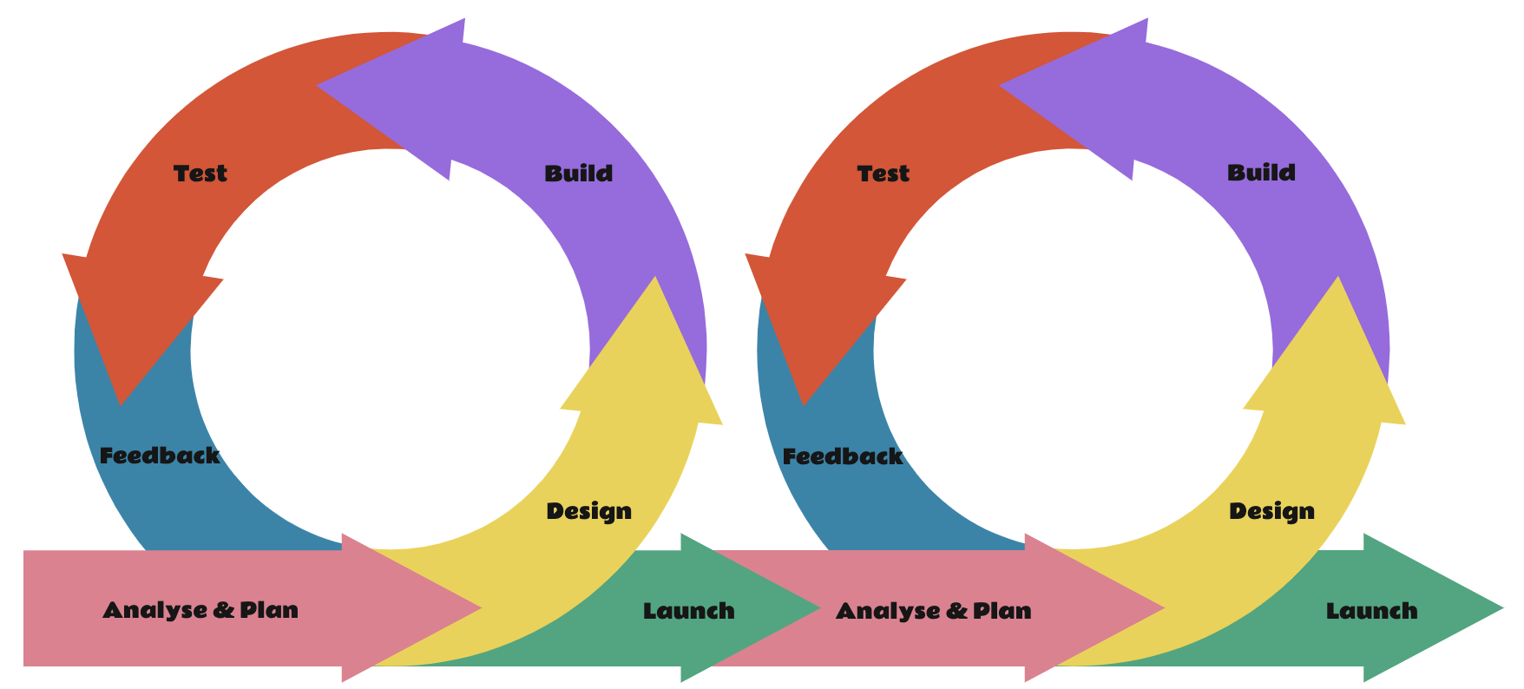
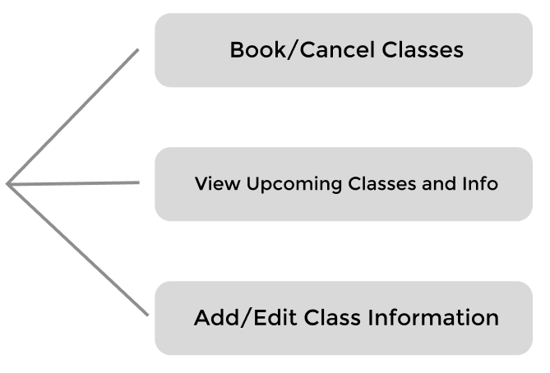
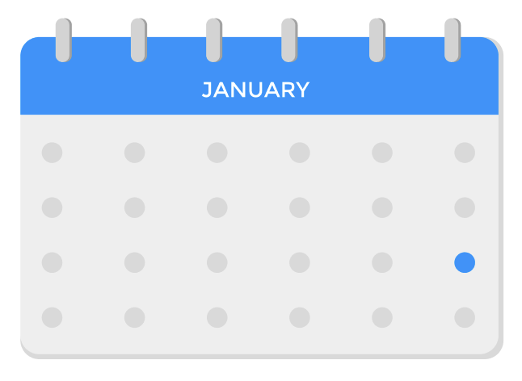
Agile Development Approach
What?
Why?
How?
https://wepik.com/template/modern-agile-diagram-r-526068295
Notes:
What is the agile development model and how does it relate to the traditional Software Development Life Cycle?
Agile development is unlike a traditional waterfall model which looks to develop a product in a very sequential manner completing each of the phases completely before moving onto the next. Agile looks to split the system and its features down into small tasks which can be rapidly developed in phases named sprints.
These rapid development cycles give rise to opportunities for high levels of collaboration, flexibility and stakeholder involvement throughout each of the sprints and by proxy the entire development of the software product.
You can see in the diagram how each of the design iteration follows a similar set of phases.
The feedback phase is a key part of the agile development cycle as this is where stakeholders can have the most influence on the design, in which they can either accept the design or provide feedback which prompts another sprint.
Why was agile development chosen for this project?
Agile development works very well for smaller teams such as ours as it allows the development process to be highly flexible and adapt to not only the team resources and timescales but also to the possible changing stakeholder requirements throughout the development process. This helps to easily manage time and resources as well as integrate stakeholder feedback throughout the development cycle.
Agile development also aligns particularly well with the chosen software architecture which will be discussed in the slides to follow.
How will we look to implement agile development?
This is perhaps best explained through an example, let’s consider the calendar system which is desired in the app. This feature can be quite complex with several moving parts, but we can break this down into smaller more manageable components.
The sprint for the calendar feature should initially begin with gathering information from the stakeholders to determine the functional and non-functional requirements for the feature.
This information can then be used to create user stories to determine what components should be worked on during the sprint and how they can meet user requirements.
One example of a user story might be this: “As a Gym User I want to be able to view upcoming sessions and their availability so I can book and cancel sessions to suit me”.
An engineer will then take this story and begin to design the feature and implement their design.
Once the design is complete, they come back to the stakeholder for feedback depending on the feedback from the stakeholders the feature will either be deployed/integrated or feedback which will be taken on board and worked on in a future sprint.

Slide 4



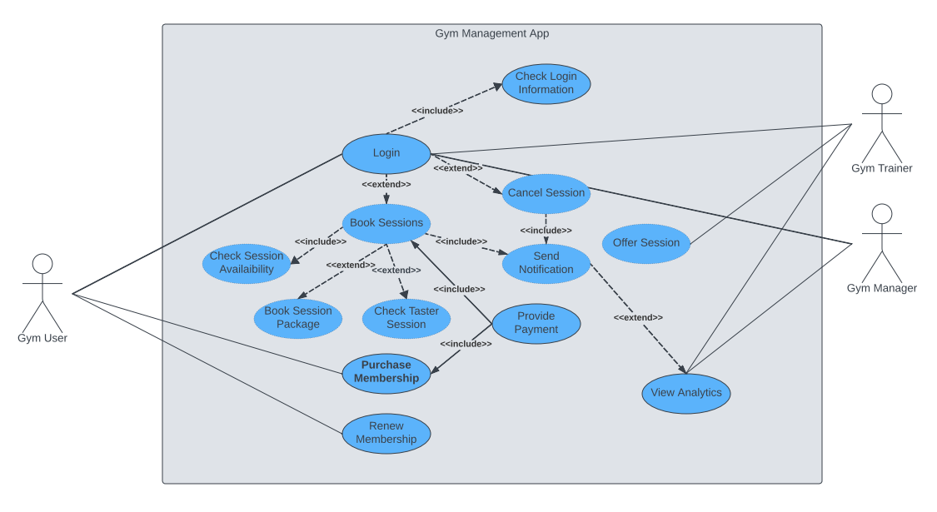
Your Project Needs – Gathering Requirements
What?
Why?
How?
Image by vectorjuice on Freepik
Image by pch.vector on Freepik
Image by Storyset on Freepik
Notes:
For the product to deliver the highest amount of satisfaction it is key that the requirements are gathered from the stakeholders. These requirements help to tell the development team what goals and success criteria they need to work towards for successful delivery.
These are important as they help to make sure that the product delivered meets the needs of all the stakeholders and also ensures clear goal setting which can be used to allocate time and resources during development to ensure efficiency.
For your gym app we will be undertaking several different approaches to ensure the requirements both functional and non-functional are adequately captured.
Functional requirements could be something like a calendar app which allows users to book and cancel sessions.
Non-functional requirements could be something like the product must be able to scale sufficiently with a growing user base.
These approaches include interviews where open-ended questions will be asked to gain an understanding of user needs and frustrations, observations where users will be observed using the existing system to get an understanding of what they feel works well and doesn’t and workshops which will allow all stakeholders including gym users, trainers and managers to sit down to discuss their requirements collectively to ensure a cohesive set of requirements with no conflicts.
We will be employing a prioritisation technique named MoSCoW which helps to aid in giving clear goals and managing project team expectations.
Based on the initial brief we have prepared generalised use case diagram for the system and how we think it will function.

Slide 5
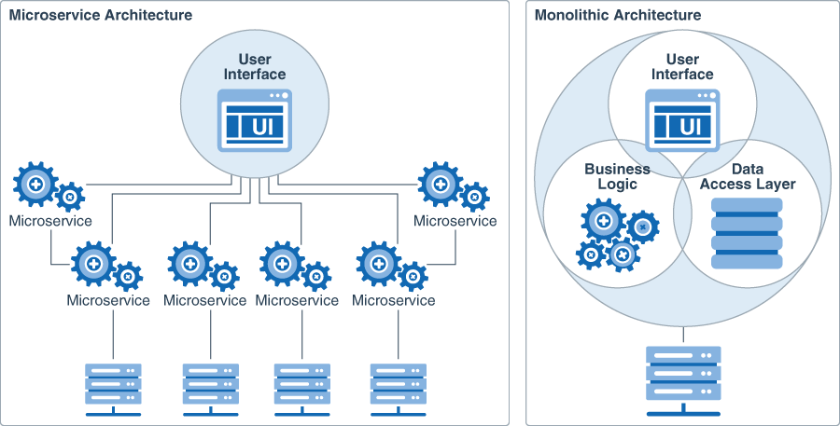
Project System Architecture
What?
Microservices
How?
https://docs.oracle.com/en/solutions/learn-architect-microservice/#GUID-1A9ECC2B-F7E6-430F-8EDA-911712467953
https://docs.oracle.com/en/solutions/learn-architect-microservice/#GUID-1A9ECC2B-F7E6-430F-8EDA-911712467953
Notes:
Firstly, I will start by explaining what system architecture is and why it is a useful component of software development.
Software system architecture can often be described as how the software system is organized. It involves the definition of different system components and how these interact with one another to form a cohesive software system.
It is a very important component of software development as it forms a key part of how engineers and programmers think and reason about the system and also how they are able to make changes and maintain this system in the future.
The two most popular types of system architecture are Monolithic and Microservices. Both offer their own strengths and weaknesses. Monolithic architecture looks to encapsule all of the functionality within a single codebase with components tightly coupled together. Whilst Microservices looks to split the system into several smaller independent components which all communicate to form a larger system.
It has been decided that the system for your application will be a Microservices Architecture System. This type of system involves splitting the system into several smaller independent components or services which all communicate together in order to form a cohesive system which works together to deliver the product to the end user.
The main advantage of this type of system from a development perspective is the flexibility it gives to the design team as it means these components can be developed, tested and maintained separately from the others. It also provides an enhanced level of robustness over something like a monolith system which can experience system-wide failure if there is a failure in a single component. This type of system architecture also offers great benefits when it comes to scaling, as your app grows in popularity and gains traction with users you will want the infrastructure to keep up with the demand, in this type of architecture components can be scaled individually instead of scaling system-wide which could prove to be more costly as the user base grows.
The system will be split into a few main services, which are as follows:
User Management
Schedule Management
Payment Management
Notification Management
Analytics These components will all communicate with each other and with the user interface to allow users to access these services.

Slide 6
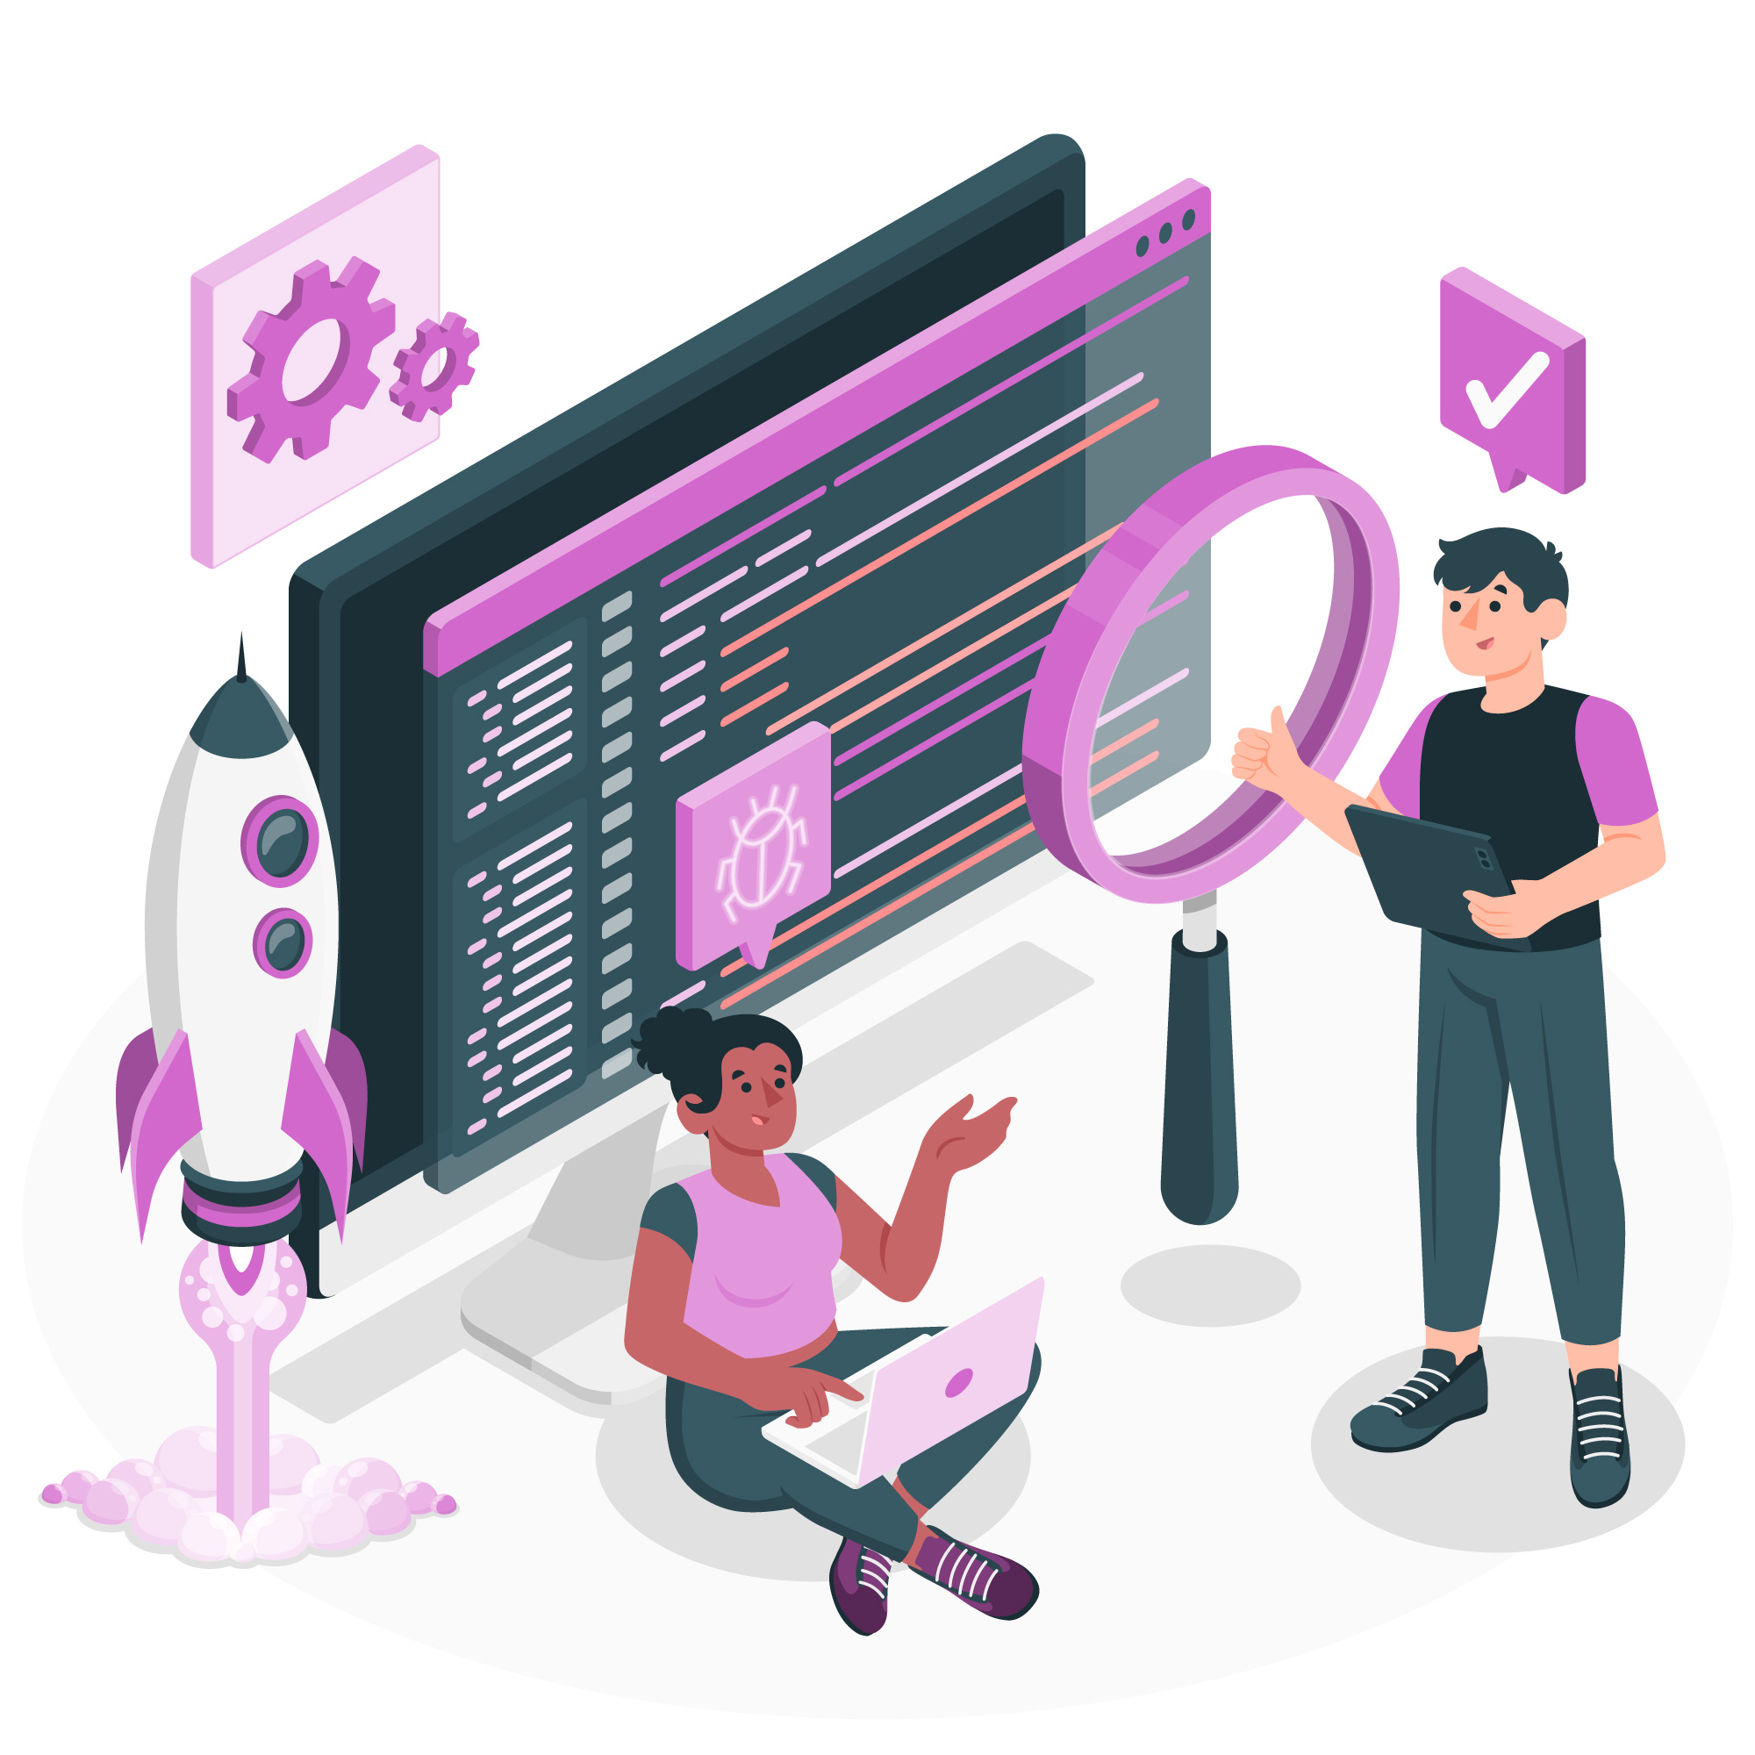
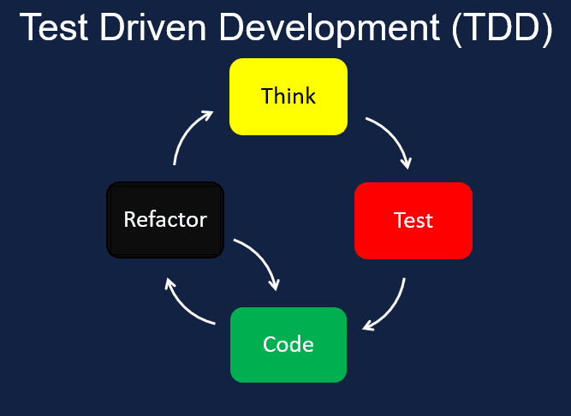
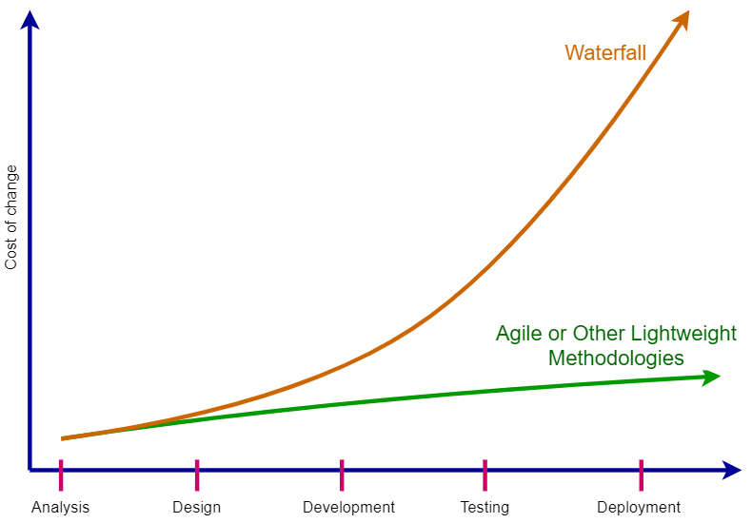
Software Testing and Quality Assurance
What?
Why?
How?
https://softwaredominos.com/home/software-design-development-articles/waterfall-agile-and-devops-a-critique-of-current-challenges/
Image by storyset on Freepik
https://www.kaizenko.com/what-is-test-driven-development-tdd/
Notes:
Software testing and quality assurance is a process which is carried out as part of the software development cycle.
The main purpose of this is so not only does the delivered product meet the requirements of the stakeholders but also helps to minimise the likelihood of a system failure after deployment to the users.
These system failures can often be very costly can have a detrimental effect on the user experience and can result in a lack of trust from the user towards the system and by extension your company.
In the Agile development model we have chosen, testing is a continuous process which is carried out throughout the development life cycle instead of just at the end which is typical in something like the waterfall approach.
This ensures that not only is the system meeting the requirements of the customer but also helps to cut down on the cost of fixing errors by catching them early instead of after the system has been fully deployed.
We will look to employ the following testing methods throughout development:
Test Driven Development Approach – This involves writing tests before a single line of code is written, this helps not only to set goals for the aspect being tested but also helps speed up testing and reduce bugs immensely.
Unit and Integration Testing – Since we are employing a microservices system architecture for the app each of the smaller independent components will be tested independently as they are developed. Once a component is fully developed testing on how this integrates with the wider system will be carried out to make sure there are not issues.
Security Testing – Since the gym app involves the handling and storing of sensitive user and payment information it is a critical aspect to ensure there are no major security breaches of the software which could result in a large cost for the business. This is particularly key in the microservices architecture where passing of data between components is a key aspect of the system.

Slide 7
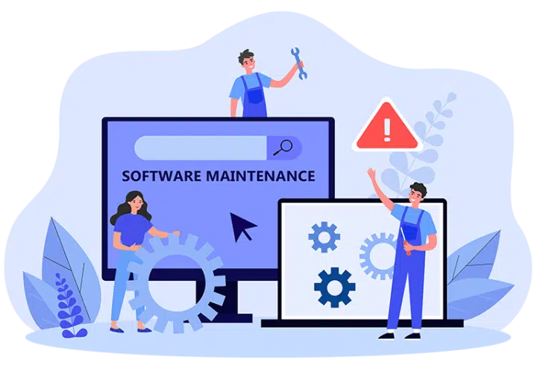
Maintenance and the Future
What?
Why?
How?
https://www.standardfirms.com/software-maintenance-plan-benefits-2/
Notes:
Once the gym app is completed and deployed fully to the users for them to begin using it is always a possibility that the testing during the design was not able to capture all of the bugs or errors in the system. It is also possible that new features and functionality or scaling may be required as the app grows and the user base changes.
This is why it is important to have a robust strategy for maintaining and extending software systems after the product has been released as bugs can not only have detrimental impact on customer experience but could lead to the leaking of sensitive user data.
For context, research suggests that around 25% extra costs and resources are typically spent on finding and resolving software issues so it must do correctly to minimize project costs.
The maintenance strategy for the gym app will follow the same agile approach as the software development of the app, allowing the efficient allocation of resources and time to quickly resolve bugs in the system and add newly requested features.

Slide 8
How Can You Help?
Requirements Gathering
Agile Development
Notes:
So how can you help?
We want to get as much stakeholder involvement throughout the development process as possible. This will help immensely towards achieving a product which meets and perhaps even exceeds requirements.
As previously discussed, we will require your participation in several aspects of requirements gathering at various stages to ensure that features are being developed which meet requirements and help to have clear set of goals for each step of the project to effectively manage resources and time.
The agile development approach thrives on constant and effective communication between all parties to ensure rapid development of high quality products. We will value and integrate your feedback throughout the development process to ensure the highest quality of product produced and enhance trust and transparency between all parties.

Slide 9
THANK YOU
Notes:
I’d like to take this time to thank you for listening and hope this presentation was helpful into giving insight into how the software development process works, how the choices were made for the gym app and how you can help with the process to make sure the product delivered is of very high quality.

